Slide 1
Using NLP to Compare Popular Authors
By Anushka Kulkarni and Dipashreya Sur

Slide 2
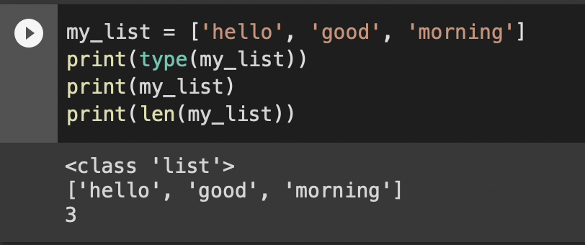
Lists Data Structure (Python)
List: ordered data structure separated by commas and enclosed within square brackets

Slide 3

NLP and NLTK (Python)
NLP: makes natural human language usable for computers
NLTK: Python package used for NLP
text preprocessing
text analysis
visualizations

Slide 4
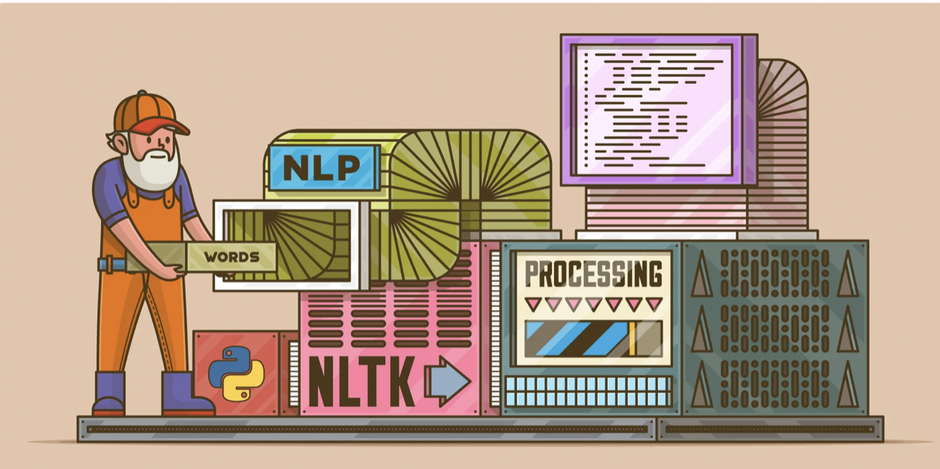
NLP and NLTK (Python)
img src: https://realpython.com/nltk-nlp-python/#getting-started-with-pythons-nltk

Slide 5
Text Preprocessing: Stop words
Stop words:
very common in English language
not useful for understanding the semantics of a sentence
predefined within the nltk Python package

Slide 6
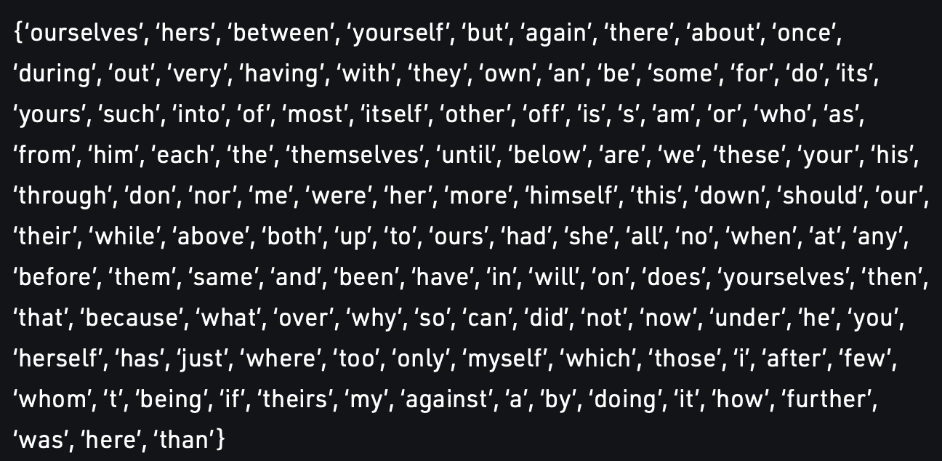
Text Preprocessing: Stop words
Stop words:
very common in English language
not useful for understanding the semantics of a sentence
predefined within the nltk Python package
image src: https://www.geeksforgeeks.org/removing-stop-words-nltk-python/

Slide 7
Tokenization
Tokenization:
NLTK Tokenize Package
Divides strings into lists of substrings
i.e. find the words and punctuation in a string
Two approaches: tokenizing by word and tokenizing by sentence

Slide 8
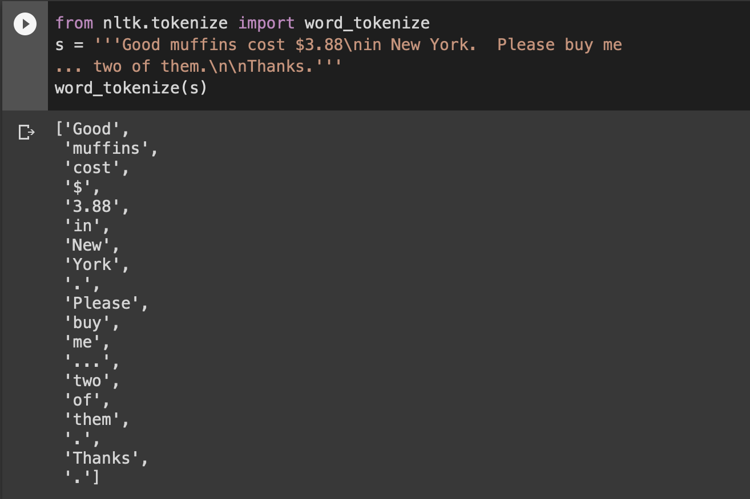
Word tokenization Ex. 1
Examples adapted from: https://www.nltk.org/api/nltk.tokenize.html

Slide 9
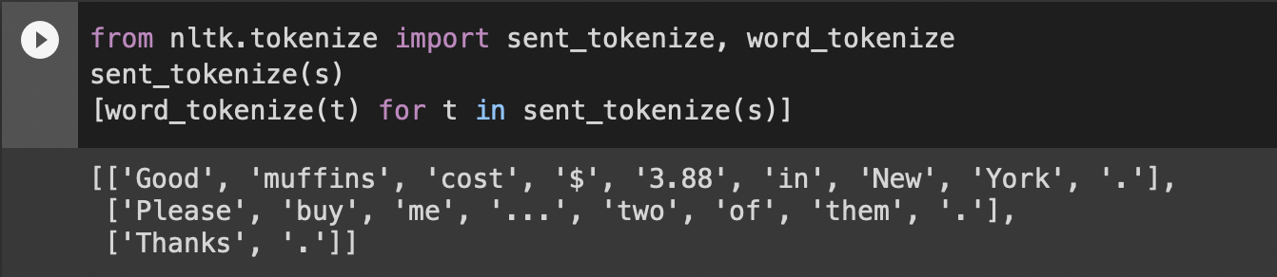
Sentence Tokenization Ex. 2
Examples adapted from: https://www.nltk.org/api/nltk.tokenize.html

Slide 10
Tokenization Ex. 1 Tokenization Ex. 2
Examples adapted from: https://www.nltk.org/api/nltk.tokenize.html

Slide 11
Lemmatization
lemma: base of a word
am, are, is be
car, cars, car’s, cars’
lemmatization: typically removing the endings of a word to reveal the lemma
you are not better than me
the boys’ cars are different colors
Examples adapted from: https://nlp.stanford.edu/IR-book/html/htmledition/stemming-and-lemmatization-1.html

Slide 12
Lemmatization
lemma: base of a word
am, are, is be
car, cars, car’s, cars’ car
lemmatization: typically removing the endings of a word to reveal the lemma
you are not better than me
the boys’ cars are different colors
Examples adapted from: https://nlp.stanford.edu/IR-book/html/htmledition/stemming-and-lemmatization-1.html

Slide 13
Lemmatization
lemma: base of a word
am, are, is be
car, cars, car’s, cars’ car
lemmatization: typically removing the endings of a word to reveal the lemma
you are not better than me you be not good than me
the boys’ cars are different colors the boy car be different color
Examples adapted from: https://nlp.stanford.edu/IR-book/html/htmledition/stemming-and-lemmatization-1.html

Slide 14
n-grams
ngrams: continuous words or symbols in a document
classified into the following types:
n | term
1 | unigram
2 | bigram
3 | trigram
n | n-gram
Examples adapted from: https://www.analyticsvidhya.com/blog/2021/09/what-are-n-grams-and-how-to-implement-them-in-python/

Slide 15
n-grams
Let’s understand the n-grams for the following sentence:
“I go to school in New York”
n | term | generated n-grams
1 | unigram | [“I”, “go”, “to”, “school”, “in”, “New”, “York”]
2 | bigram | [“I go”, “ go to”, “ to school”, “school in”, “in New”, “New York”]
3 | trigram | [“I go to”, “ go to school”, “to school in”, “school in New”, “in New York”]
Examples adapted from: https://www.analyticsvidhya.com/blog/2021/09/what-are-n-grams-and-how-to-implement-them-in-python/

Slide 16
Google Colab Notebook
link: https://tinyurl.com/csc-workshop-NLP

Slide 17
Emotion Detection
Sentiment Analysis: classifying text into sentiments
Emotion Detection: classifying text into emotion labels
Machine Learning Model: EmoRoBERTa by Arpan Ghosh
28 emotions detected i.e. admiration, disappointment, and surprise
context based analysis
Applications: Twitter tweets, Analyzing popular authors’ novels
src: learn.microsoft.com/en-us/windows/ai/windows-ml/what-is-a-machine-learning-model, https://huggingface.co/arpanghoshal/EmoRoBERTa

Slide 18
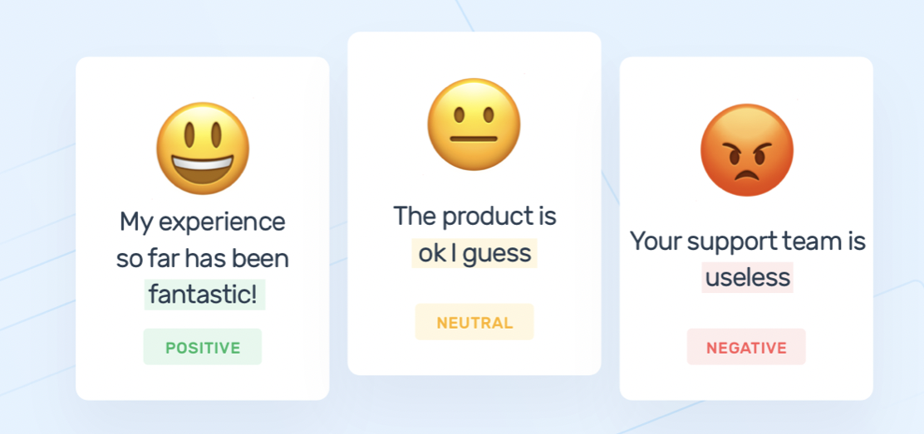
Sentiment Analysis Ex.
img src: https://medium.com/analytics-vidhya/tweet-sentiment-extraction-e5d242ff93c2

Slide 19
How do humans interpret text?
The sun of a September evening--we need not say in what year--was
shining down a wild and lonely glen, a few miles eastward from the
head of Loch Lomond, where a boy and a girl sat on the slope of the
green hill-side, watching a herd of fifteen red-eyed, small, and
shaggy black cattle, with curly fronts and long sharp horns, that
were browsing mid-leg deep amid the long-leaved fern. The place was
one of stern and solemn grandeur. - Grant
What are important words and phrases in the text?
What emotions does the author express?
Semantics: the branch of linguistics and logic concerned with meaning

Slide 20
How do computers interpret text?
Computer: (lemmatized, removing stop words)
The sun September evening -- need say year -- shining wild lonely glen , mile eastward head Loch Lomond , boy girl sat slope green hill-side , watching herd fifteen red-eyed , small , shaggy black cattle , curly front long sharp horn , browsing mid-leg deep amid long-leaved fern . The place one stern solemn grandeur . - Grant
What important context gets lost in this version?
What becomes clearer?

